Slide 1





Role of the
E.L.D. Teacher
with
Kelly Reider

Slide 2
What is an
E.L.D. Teacher?
English language development
ESL ESOL ELA CLD ENL

Slide 3
Mandated by NCLB
renewed with ESSA
Must have an ESL certified teacher with a research based standards/curriculum
Must have a screening assessment
Must have an annual assessment
Accountable for english proficiency growth and academic success

Slide 4
E.L.D. Teacher
Must have regularly scheduled instructional time for English language development

Slide 5
Program Models
Co-Teaching
Push In
Pull Out
Sheltered Content Instruction

Slide 6
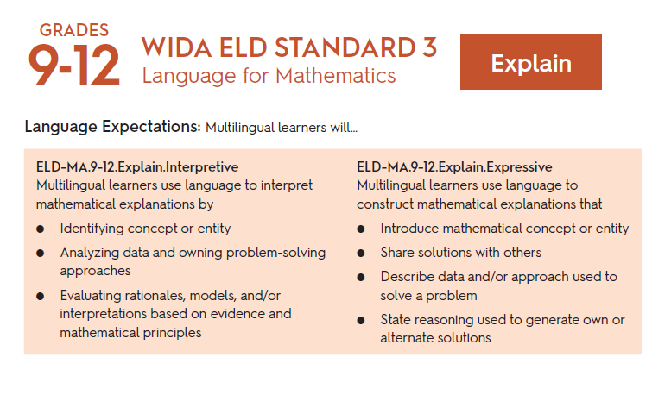
Regardless of the program model, the ELD teacher must be teaching language outcomes attached to an ELD Standard

Slide 7
Can help with, but should not be the lead on...
interpretation and translation
enrollment
re-teaching tier 1 instruction
interventions

Slide 8
info@englishlearnerportal.com
with
Kelly Reider

